Slide 1
Writing Cloud-Enabled Apps with Cordova and Visual Studio

Slide 2
Topics
Introduction
Getting Started
Cordova Development Concepts
Communicating with the Cloud
Notes:
Objective: Discuss the agenda for the deck
Notes:
The deck is broken into 4 sections that discuss:
An Introduction to Apache Cordova
Getting Started with the Visual Studio Tools for Apache Cordova (TACO)
A general overview of Cordova Development in Visual Studio Concepts
Communicating with the Cloud from your Cordova Apps

Slide 3
Introducing Apache Cordova
Notes:
Objective: This section will provide a high-level introduction to Apache Cordova and the Tools for Apache Cordova (TACO) available in Visual Studio.

Slide 4
A Spectrum of App Development Options
Native
Use platform-provided tools for app development
Native Hybrid
Write code in a common language/framework
Web
Platform-agnostic HTML code
Create a unique code stack for each targeted device family
Access to device hardware governed by browser capabilities
Lowest common denominator
Web Hybrid
Examples include Apache Cordova (HTML & JavaScript), React Native (JSX & JavaScript)
Resulting app is compiled into native executables
Examples include Xamarin, NativeScript
App is written in web-based languages that are processed at runtime
The app shell interprets the code and layout and handles logic and rendering
“App within an app”
Runs in a browser on the device
Notes:
Objective: To compare and contrast several typical different approaches to mobile app development
Notes:
The tools available for developing mobile apps are available in a spectrum of options.
Native – app is written using languages and tooling generally provided by the platform creator. App code directly calls the APIs exposed by the platform. Result is a compiled artifact that contains the code and resources the app needs to run. The code written this way targets a single platform at a time, with multiple parallel development efforts required to target multiple platforms.
Native Hybrid – app is written using a common/intermediate language & tooling. App code calls an intermediate API that abstracts & generally homogenizes the APIs exposed by the various targeted platforms (to different degrees, considering examples like “classic” Xamarin and Xamarin Forms.) Result is several compiled artifacts that contain the code and resources the app needs to run. The code written this way targets multiple platforms simultaneously, with some room for inserting platform-specific handling (generally as shims.) The goal here is to maximize code reuse and “write-once, run-many.”
Web Hybrid – app is written using web-targeting technologies or platforms. These platforms provide APIs that the app can call that abstract & generally homogenize the APIs exposed by the various targeted platforms. The result is an app “shell” that hosts a running app within that shell, or perhaps “an app running within an app.” Browser behavior, CSS, and JavaScript, as well as additional HTML/JavaScript frameworks (like Ionic) interact to simulate device-specific characteristics & behavior. One example of a platform in this space is Apache Cordova, which hosts a WebView control that renders HTML & interprets JavaScript. Facebook’s React Native is another example.
Web App – the user access the functionality with the a browser installed on their device, and the app is (often) optimized for display and execution on the device form-factor using “responsive design” concepts. In this case, access to the device capabilities is governed by what the browser can access. This is generally the “lowest common denominator” for app development.
Note that like a color spectrum, there are cases where the different options “bleed into” each other, and cases that fall into the middle grounds. Examples of such crossovers include:
Hosted Web Apps – A platform-native app that “points” to an App URL. The app is loaded from the platform’s App Store (or otherwise is “installed” to the device), rather than launched from a browser with a URL. Unlike a Web Hybrid app, the app continues to run on the server (as much as it normally does when viewed in a browser) – these apps cannot be run offline.
Native (or Native Hybrid) apps that include portions of the apps that are implemented as Web Hybrid apps

Slide 5
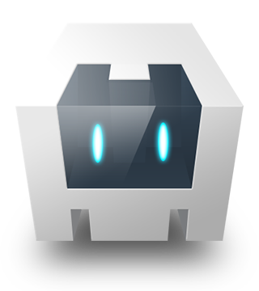
Apache Cordova Overview
Open-source framework for mobile development using standard web technologies
Supports cross-platform development
Content is rendered and interaction is managed within the WebView, which bridges to the Mobile OS
Plugins provide additional bridges to the device & mobile OS APIs
Supports working with JavaScript frameworks, including Angular, React, and Ionic.
Cordova Application
Web App
Cordova Plugins
HTML/JS/CSS
Accelerometer
Media
Geolocation
Contacts
Camera
Network
HTML Rendering Engine (WebView)
Device
Storage
Custom Plugins
Mobile OS
Services
Input
Sensors
Graphics
Notes:
Objective: Introduce Apache Cordova
Notes:
Apache Cordova is an open-source framework for developing mobile apps with standard web technologies (HTML5, CSS3, JavaScript). This is particularly useful for cross-platform development in organizations that already have strong HTML/JavaScript development expertise.
In Cordova, your app is built as HTML/CSS/JavaScript components, related resources, and a configuration file. The app framework provided by Cordova manages the presentation of a WebView control that displays and interacts with these assets and coordinates communication between the app and the underlying mobile OS.
The Cordova app framework is extensible via Plugins. Plugins allow for additional communication between apps and native components, allowing native code to be invoked from JavaScript. The Cordova project manages a set of predefined “Core Plugins” for device interaction, camera interaction, etc. Additionally, custom plugins can be defined. 3rd party plugins can be found at http://cordova.apache.org/plugins or via NPM.
Finally, because the app uses native webview controls, the HTML is the same as what you would write for any other web application – meaning you can incorporate JavaScript frameworks to help with the application structure and development, including popular frameworks like React, Angular, and Ionic.
Source: http://cordova.apache.org/docs/en/latest/guide/overview/index.html

Slide 6

TACO - Visual Studio Tools for Apache Cordova
Installs via Visual Studio installer
Provides support for Project Templates, syntax highlighting, Intellisense and other Visual Studio development tooling.
Debug and test from within the Visual Studio IDE. Apps can be run in the Apache Ripple simulator, on device/platform emulators, or on actual devices.
Manage plugin settings from within the Visual Studio UI
Integrate with other Microsoft services from within the Visual Studio IDE
Notes:
Objective: Introduce the Visual Studio TACO tools
Notes:
If you are targeting Windows, iOS, and/or Android apps with your Cordova app, the Visual Studio Tools for Apache Cordova (also known as TACO) can help. The TACO tools provide project templates for creating Cordova projects based on both JavaScript and TypeScript. Working in Visual Studio enables you to bring the power of the Visual Studio IDE – widely regarded as one of the most powerful developer tools available – to your Cordova project. With Visual Studio, you get access to features like syntax highlighting, Intellisense, GUI-facilitated project and plugin configuration, integrated debugging, and built-in app deployment tooling.
More information on the TACO tools can be found at https://www.visualstudio.com/vs/cordova/ and https://taco.visualstudio.com

Slide 7
Getting Started with the Visual Studio TACO Tools
Notes:
Objective: Introduces the steps developers will encounter when working on Cordova projects with the Visual studio TACO tools.

Slide 8
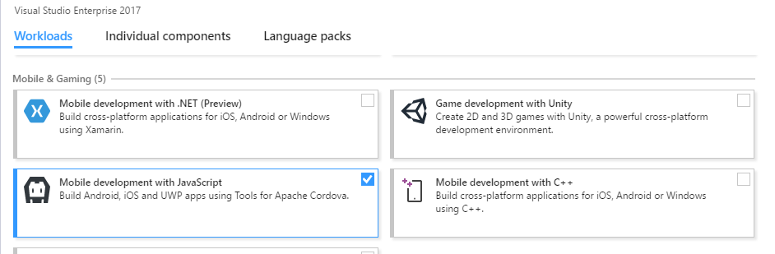
Installation
Specify the “Mobile Development with JavaScript” Workload from the Visual Studio 2017 installer
Notes:
Objective: Show what needs to be done to install the TACO tools in Visual Studio 2017
Notes: The Visual Studio 2017 features a different take on the previous Visual Studio installers, where “Features” are replaced by “Workloads.” To install the TACO tools in Visual Studio 2017, you select the “Mobile Development with JavaScript” workload from the “Mobile & Gaming” section in the installer.

Slide 9
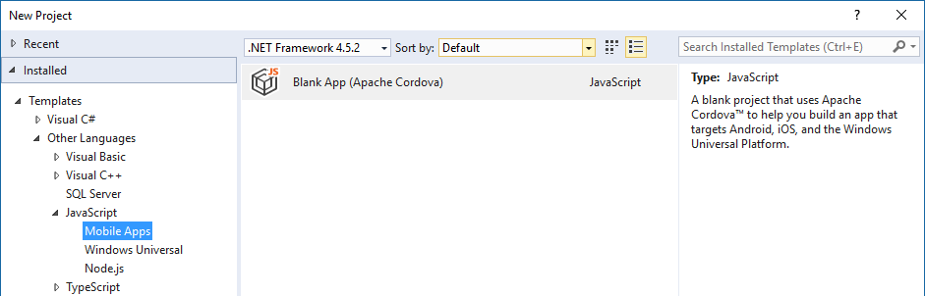
Creating a Project
Create a new project by selecting the “Blank App (Apache Cordova)” template from either the JavaScript or TypeScript project nodes.
Notes:
Objective: To show how to start a new Cordova project in Visual Studio 2017 with the TACO tools
Notes: To create a new Cordova project in Visual Studio 2017, select File/New Project, then select the “Mobile Apps” option. Note that the JavaScript node may or may not be located under “Other Languages”, depending on the Visual Studio settings and what features have been included.
From the “Mobile Apps” node, select the “Blank App (Apache Cordova)” project to create the new project.
Note – the .NET framework version selection is irrelevant

Slide 10
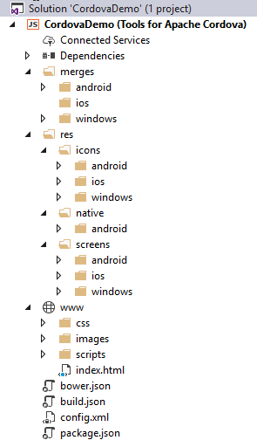
Project Structure
www Folder
Contains HTML, JavaScript, CSS, images, and other files that make up the web portion of your app
merges Folder
Contains platform-specific files that override their equivalent files in the www Folder
res Folder
Contains icons, splash screens, and other files needed by each targeted app platform
Configuration Files
Individual files that contain settings used for building your Cordova project
Notes:
Objective: To explain the folder and content layout of a typical TACO project
Notes: When you create a new TACO project in Visual Studio, your project will be set up with several folders and files.
The “www” folder contains the web content that will be presented in the hosted WebView that has been discussed previously. It contains a project folder similar to what you are accustomed to from other web development, including folders for css content, image resources, script files, and HTML content.
The “merges” folder contains folders for your target platforms. Within these folders, you can place files that will be copied into the corresponding folders within your project’s “www” folder when your app is run on the specific platform, overwriting pre-existing files if present. This way you can provide platform-specific implementations or shims when the application design or platform details require it.
The “res” folder is where you can place resources and other files that are needed by the app platform to build your project. These include things like app launch icons, splash screen designs, and similar files.
The default project also contains several configuration files. Among these, the most important is the config.xml file. This file contains the Cordova settings for your app, including the platform-specific package information, target OS versions, default app start page, version number, supported orientation, security settings, and which plugins will be used by/included in your app.

Slide 11
Cordova Development Concepts in Visual Studio
Notes:
Objective: This section will discuss three key aspects of Cordova development in Visual Studio:
Specifying platform-specific content
Working with Plugins
Debugging options

Slide 12
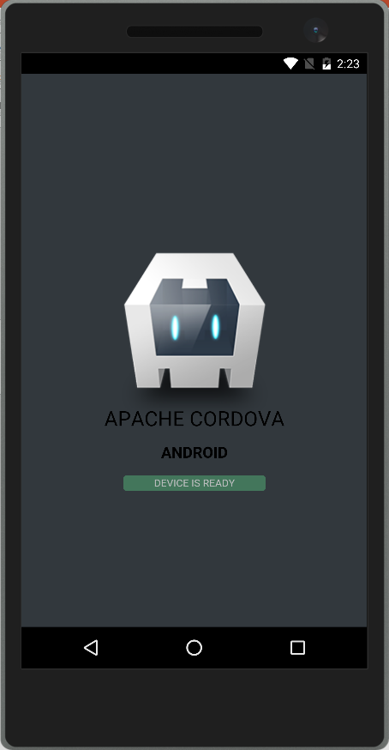
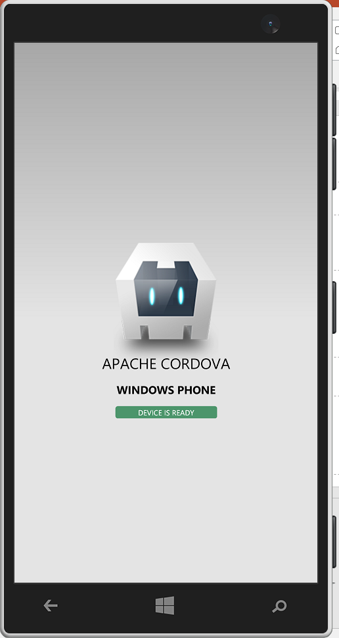
Including Platform-Specific Content
Content that is specific to a given platform can be placed into the corresponding platform folder inside the merges folder.
<div class="app">
<h1>Apache Cordova</h1>
<h2>Platform</h2>
<div id="deviceready" class="blink">
<p class="event listening">Connecting to Device</p>
<p class="event received">Device is Ready</p>
</div>
</div>
In merges/android/scripts/platformOverrides.js
$("h2").replaceWith("<h2>Android</h2>");
In merges/windows/scripts/platformOverrides.js
$("h2").replaceWith("<h2>Windows Phone</h2>");
Notes:
Objective: To show the techniques available for creating content specific to a given platform
Notes:
When building for a specific platform, if a file in the “merges” folder matches a pre-existing file that already exists in www, then the www file is overwritten with the merges content. In this example, the HTML contains an element with some default text. Furthermore, the jQuery utility library has been added to the project. In the “merges” folder for each platform, a jQuery selector is used to replace the content of the given element with some text that is specific to each platform.
This technique is not just limited to just JavaScript content – it can include platform-specific CSS files (for platform-specific styling), platform-specific images, and even platform-specific HTML files (which in turn can include platform-specific HTML and CSS files.)

Slide 13

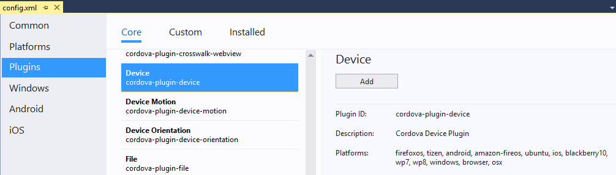
Working With Cordova Plugins
Plugins provide your app’s JavaScript access to the device and OS APIs
Plugins to be included in an app are declared in the config.xml file
var devicePlatform = device.platform;
var deviceId = device.uuid;
$("h2.second").replaceWith("<h2>" + devicePlatform + " " + deviceId + "</h2>");
Notes:
Objective: To show the techniques to be used for working with plugins in a Cordova project
Notes:
When you need to include additional functionality in your Cordova project, this will usually be provided via a plugin. To select a plugin, you can open the config.xml file editor in Visual Studio. From here you can browse the list of Core plugins, or you can import a Custom plugin.
One a plugin has been imported, it can be referenced from within the application JavaScript code. Note that some plugins are only available in a subset of the possible platforms, so it may be necessary to put the plugin code in platform-specific override files.
In the example above, the Core “Device” plugin is selected. This plugin provides access to device-specific information such as Platform, Device ID, Current Version, etc. Once included, the app’s JavaScript code can be updated to access the methods, properties, and events exposed by the Plugin.
In addition to the Core plugins that can be seen from the Plugins panel of the config.xml editor in Visual Studio, Apache Cordova manages a registry of available plugins at https://cordova.apache.org/plugins/.

Slide 14
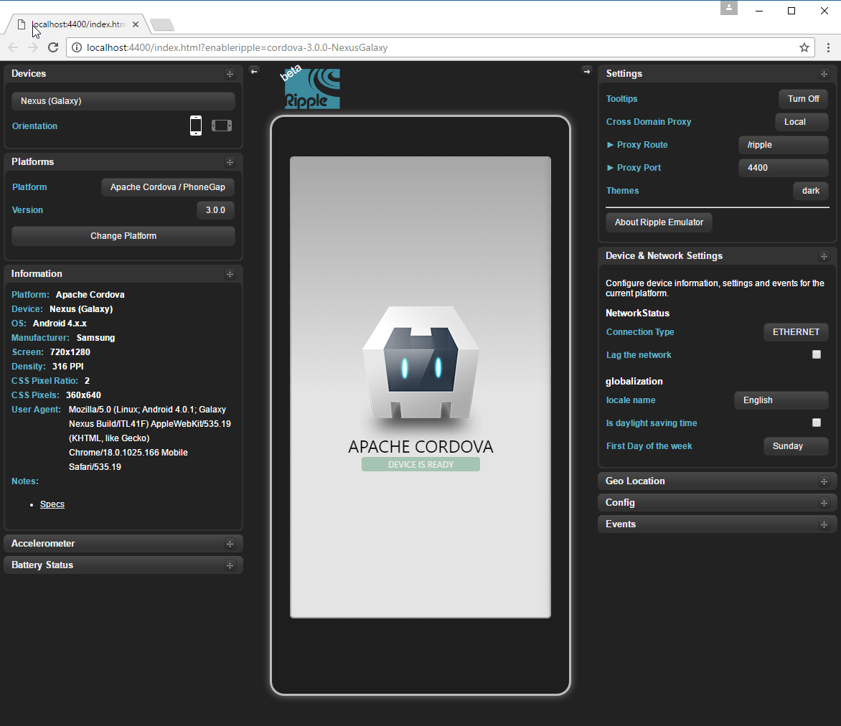
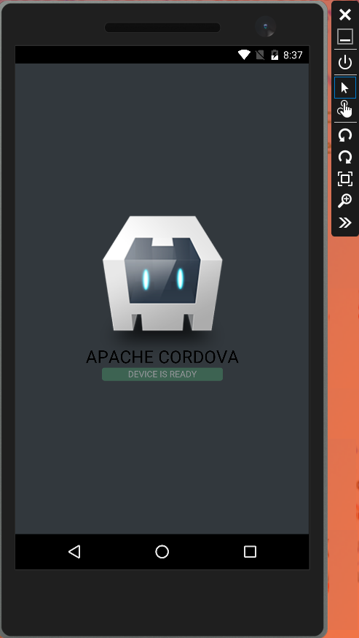
Debugging
Notes:
TODO: Add an “App running on device” picture
Objective: To present the various mechanisms available for testing and debugging Cordova apps from Visual Studio
Notes: Debug options include using the Ripple simulator, device emulators, or connecting and deploying to actual devices.
The Ripple simulator. Apache Ripple is a browser-based mobile simulator that runs in the Google Chrome browser. It allows simulating the execution of a Cordova app on a variety of iOS and Android devices, and provides support for manipulating the simulated inputs to several Core Cordova plugins like geolocation, device orientation, and accelerometer.
Device Emulators. Your app can be run on one of the configured Device Emulators. A device Emulator hosts your target device OS within a Virtual Machine, presented in a window that resembles the running device on your desktop. This allows your app to run in an environment that closely matches the actual OS on which it will run. There are several Android emulators available (Visual Studio Emulator for Android, Google Android Emulator, among others)
Connecting to an actual device. Visual Studio supports directly connecting to an actual device and deploying your app to that device, typically connected via a USB cable. To enable this functionality, your app does need to be configured to allow development (sometimes described as being “Developer Unlocked”.) Instructions for configuring and connecting your device vary between devices and manufacturers.
The Ripple is perhaps the easiest/quickest way to simulate & debug your application, but the least like the actual device experience. Likewise, using the Emulators will run your app within an actual virtual version of the device OS itself, but still does so using the hardware (RAM, CPU) of the underlying development machine. Emulators make use of different virtualization technologies, which require configuration of the development OS. If such configuration is an option (for example, setting up Virtualization when developing on a cloud-hosted VM is often not possible/practical), then the Ripple may be a better option. The most cumbersome testing/debugging technique is running on actual devices themselves. Therefore, a progression of debugging tools is recommended – initially using the Ripple for its convenience, and gradually moving to running on actual physical devices.
No discussion of mobile device testing would be complete without a mention of the Xamarin TestCloud tool. This allows you to run your application through predefined steps on a variety of cloud-hosted devices giving you one of the best-possible opportunities to see your app’s behavior on as large of a set of hardware configurations as possible (currently over 2000 different devices supported.) More information on TestCloud can be found at https://www.xamarin.com/test-cloud
NOTE: Important – before doing anything else, you should Build your project. This will pull the configured Cordova runtime and the project dependencies into your solution, requires an internet connection, and could take a few minutes to complete.
NOTE: In Visual Studio 2017, the Ripple Simulator has been replaced with the “Cordova Simulate” tool. This is very similar to the Apache Ripple tool, except that in Cordova Simulate, only the app appears in the browser. The Plugin Controls are actually hosted within Visual Studio IDE itself. More information about Cordova Simulate can be found at http://taco.visualstudio.com/en-us/docs/vs-taco-2017-cordova-simulate/. Microsoft maintains Cordova Simulate as an open source project at https://github.com/Microsoft/cordova-simulate

Slide 15
Communicating with the Cloud
Notes:
Objective: This section will discuss the options for scaling VM’s (VM sizes and storage) and also the concepts of reliability via Availability Sets

Slide 16
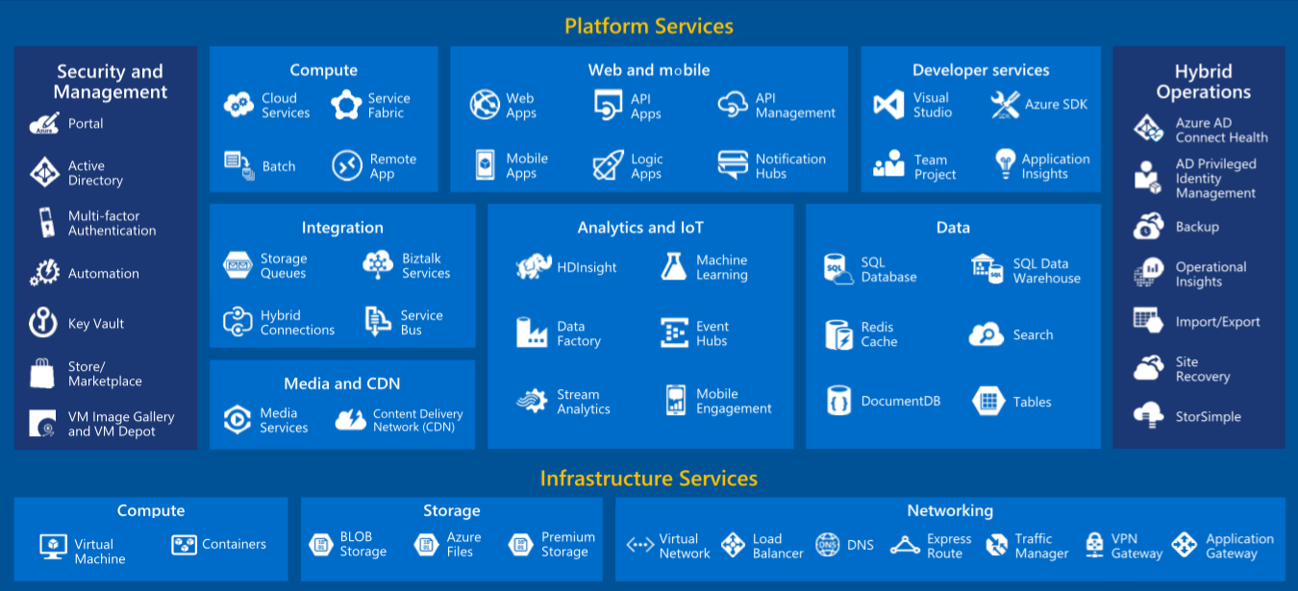
Introducing Microsoft Azure
Notes:
Objective: To Introduce (briefly) the Microsoft Azure Cloud
Notes:
Azure is Microsoft’s cloud computing platform. The platform currently offers over 120 distinct services across several different categories, including Compute, Storage, Analytics, Networking, and Security. These services can be combined in different ways to provide solutions for a myriad of different problems.
Azure service are currently provided by more than 30 regions worldwide. In fact Azure is currently deployed to more service regions than the competing Amazon and Google cloud solutions, combined.
Given that both Cloud and Mobile hit their stride at about the same point in time, there is a lot of value offered by Cloud Computing for developing and enhancing Mobile Apps.

Slide 17
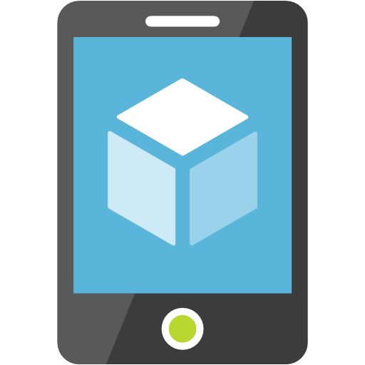


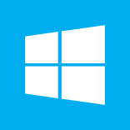
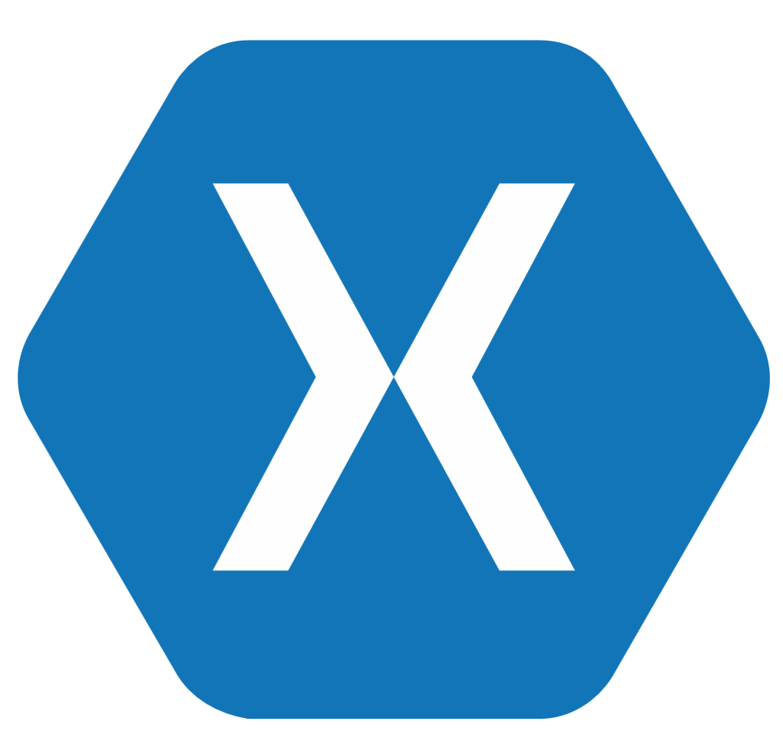




Introducing Azure Mobile Apps
Part of the Azure App Services family of offerings.
Includes both client-side and server-side tools.
Service features include data & API access, personalization via authentication & authorization, offline data sync.
Server platforms are available for both Node.js and .NET
Client SDKs are available for many different client app types
Notes:
Objective: To Introduce (briefly) the Azure Mobile Apps service
Notes:
Azure Mobile Apps is part of the Azure App Service PaaS offerings and includes both client and server-side components. On the server side, Mobile Apps builds on top of Azure Web Apps, making it easy to stand up REST endpoints for data access and management as well as custom HTTP endpoints. The service also provides for easy configuration of Authentication and Authorization via both social and enterprise identity providers, including Microsoft Accounts, Facebook, Google, Twitter, and Azure Active Directory (including AAD B2C.) The server provides options for both .NET and Node.js based development.
For the client-side of the application, the Azure Mobile Apps service provides several SDKs that facilitate communication between the app and the service.
Note that both the client and server SDKs have been published as open-source projects on GitHub

Slide 18
Azure Mobile Apps Easy Tables & APIs
Work with both tables and custom APIs directly from the Azure Portal
Easy Tables – Manage schema, clear content, delete rows, edit scripts, update permissions
Easy APIs – change access permissions for an HTTP action, edit the API script
Notes:
Objective: To Introduce the Easy Tables & Easy APIs features of the Azure Mobile Apps service
Notes:
While Azure Mobile Apps offers also supports a robust server-side programming environment both in Node.js and the .NET-backed implementations, it also provides some rapid-development tools, known as Easy Tables and Easy APIs.
With Easy Tables, you can quickly connect your Mobile App backend to a SQL Azure database and then use tooling in the Azure Portal to manage the table schema and content, edit scripts that run in response to requests for data from the tables, and set access permissions for the tables. Access permissions include allowing anonymous access, requiring authenticated requests, or restricting access so that external code cannot can the functions (only internal request would be allowed.)
With Easy APIs, you can configure custom HTTP API endpoints to perform actions that are not necessarily tied directly to a database table. From the Azure Portal, you can set the API access permissions as well as edit the API script that is executed when the API method is called. The API access permissions available are the same as those previously described for Easy Tables.
Note: Easy Tables & Easy APIs are specific to the Node.js backend implementation.

Slide 19
Cordova and Azure Mobile Apps
First, update the project to reference the Azure Mobile Apps plugin
// Create a Client Connection
var client = WindowsAzure.MobileServiceClient(appUrl);
// Access Tables
var table = client.getTable(tableName);
table.read().then(success, failure);
table.where({field: desiredValue}).read().then(success, failure);
table.insert(newItem).done(success, failure);
table.update(updateItemWithId).done(success, failure);
table.del({id: ‘id’).done(success, failure);
// Call APIs
client.invokeApi(apiName, options).done(success, failure);
Notes:
Objective: To Illustrate the basic programming concepts involved in working with Azure Mobile Apps
Notes:
To work with an Azure Mobile Apps from your Cordova application, you’ll first want to reference the Azure Mobile Apps plugin.
From there, you will create a client connection instance with the URL to your Azure Mobile App
Most of the work you will do with an Azure Mobile app will involve working with a “table”. Tables are accessed by creating a table object with the name of the table to access. This object can be used to preform CRID operations on the data in the remote table. For read operations, you can filter, sort, and paginate your results. Insert operations require an instance of the object to add; Update operations also require an instance, where the ID of the item being supplied matches the ID of the object to update. Finally, delete operations only require the ID to be set for the entry to be deleted.
In addition to working with tables, you can also call Custom APIs with the invokeAPI method.
Other supported functions include authentication and push notification support.

Slide 20
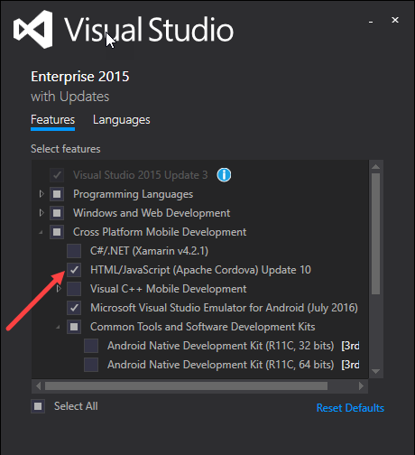
Installation – Visual Studio 2015
Select HTML/JavaScript (Apache Cordova) from the Features list in the Visual Studio 2015 installer
Notes:
Objective: Show what needs to be done to install the TACO tools in Visual Studio 2015
Notes: In Visual Studio 2015, installing the TACO tools is as simple as selecting the “HTML/JavaScript (Apache Cordova)” feature (whichever update happens to be current) under the “Cross Platform Mobile Development” node.

Slide 21
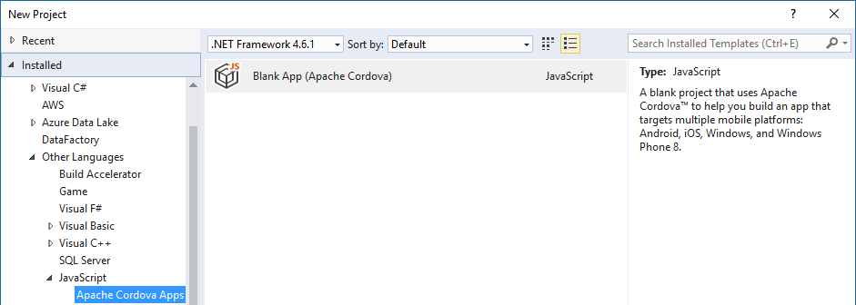
Creating a Project – Visual Studio 2015
Create a new project by selecting the “Blank App (Apache Cordova)” template from either the JavaScript or TypeScript project nodes.
Notes:
Objective: To show how to start a new Cordova project in Visual Studio 2015 with the TACO tools
Notes: To create a new Cordova project in Visual Studio 2015, select File/New Project, then select the “Apache Cordova Apps” option. Note that the JavaScript node may or may not be located under “Other Languages”, depending on the Visual Studio settings and what features have been included.
From the “Apache Cordova Apps” node, select the “Blank App (Apache Cordova)” project to create the new project.
Note – the .NET framework version selection is irrelevant

Slide 22
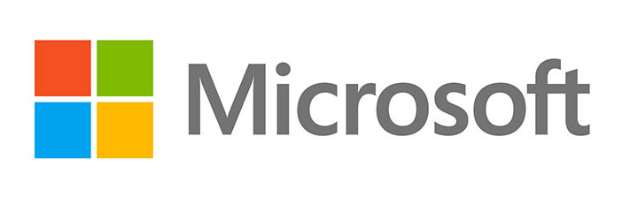



Thanks to our sponsors:

Slide 23
Demo: Sample Cordova App
Notes:
Objective: This section will provide a high-level introduction to Apache Cordova and the Tools for Apache Cordova (TACO) available in Visual Studio.

